Slide 1

Renewable Energy Optimization Algorithm
Student: Promod Chandra Das
ID: 231002005
Teacher’s Name: Farjana Akter Jui

Slide 2

Introduction
Features
Code Screenshot
Output
Future Work

Slide 3

Introduction
The growing demand for sustainable energy requires efficient algorithms to optimize renewable systems.
1. This project develops a Renewable Energy Optimization Algorithm to maximize production and minimize costs.
2. Considering environmental factors, demand, and resources,
3. it optimizes the operations of systems like solar panels and wind turbines.
Notes:
P

Slide 4

Features
Multi-objective Optimization,
Dynamic Resource Allocation,Weather Data Integration, Customizable Parameters, Efficient Algorithm Design.

Slide 5
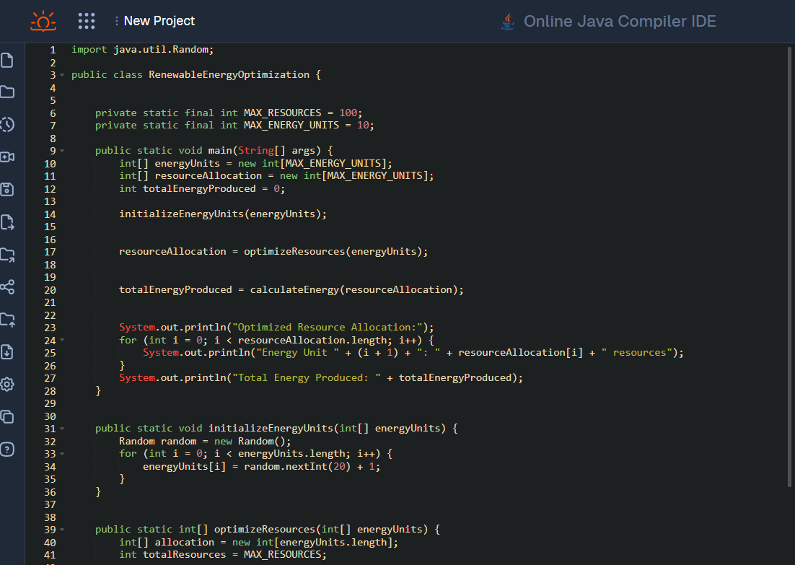
Code Screenshot(01)

Slide 6
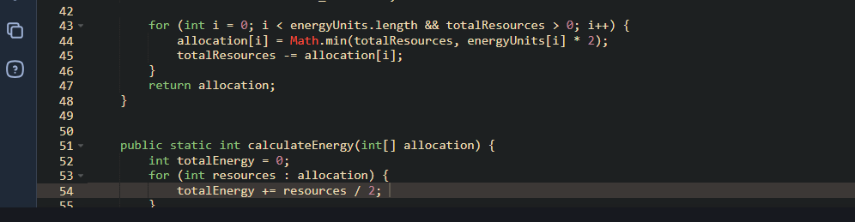
Code Screenshot(02)

Slide 7

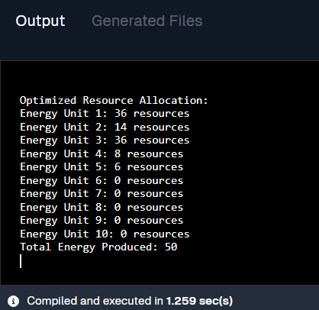
Output

Slide 8




Future Work
Advanced Optimization Techniques
genetic algorithms or machine learning models for better optimization.
Scalability Testing
Test the algorithm with larger datasets and more complex renewable energy systems.
Integration with IoT
Enable real-time data collection from renewable energy sources for more accurate resource allocation.
Grid Integration
Optimize energy distribution to integrate seamlessly with existing power grids.
Environmental Impact Analysis
Add features to assess the environmental benefits of optimized energy production.
Hybrid Renewable Energy Systems Optimization
solar, wind, and hydroelectric

Slide 9

Conclusion
This project highlights how optimization algorithms can enhance renewable energy efficiency and sustainability. Future advancements will improve scalability, adaptability, and integration, driving smarter and more reliable energy systems globally.

Slide 10
Thank You Have you any Questions?

